Slide 1
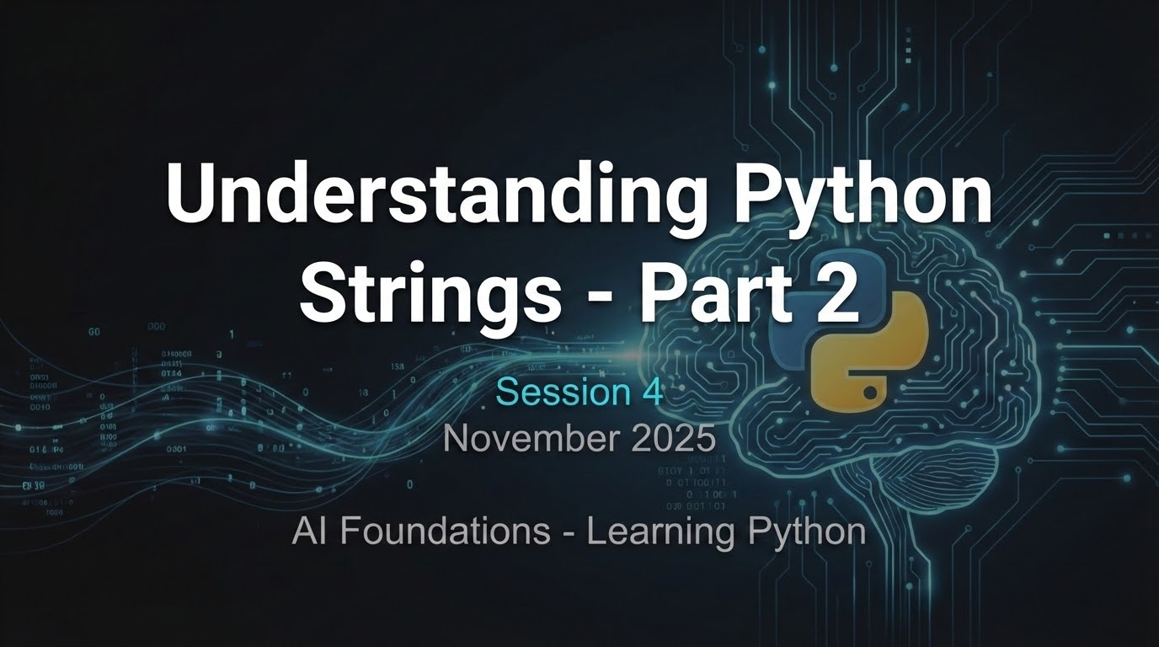
Understanding Python Strings - Part 2
Session 4
November 2025
AI Foundations - Learning Python

Slide 2
f-Strings

Slide 3
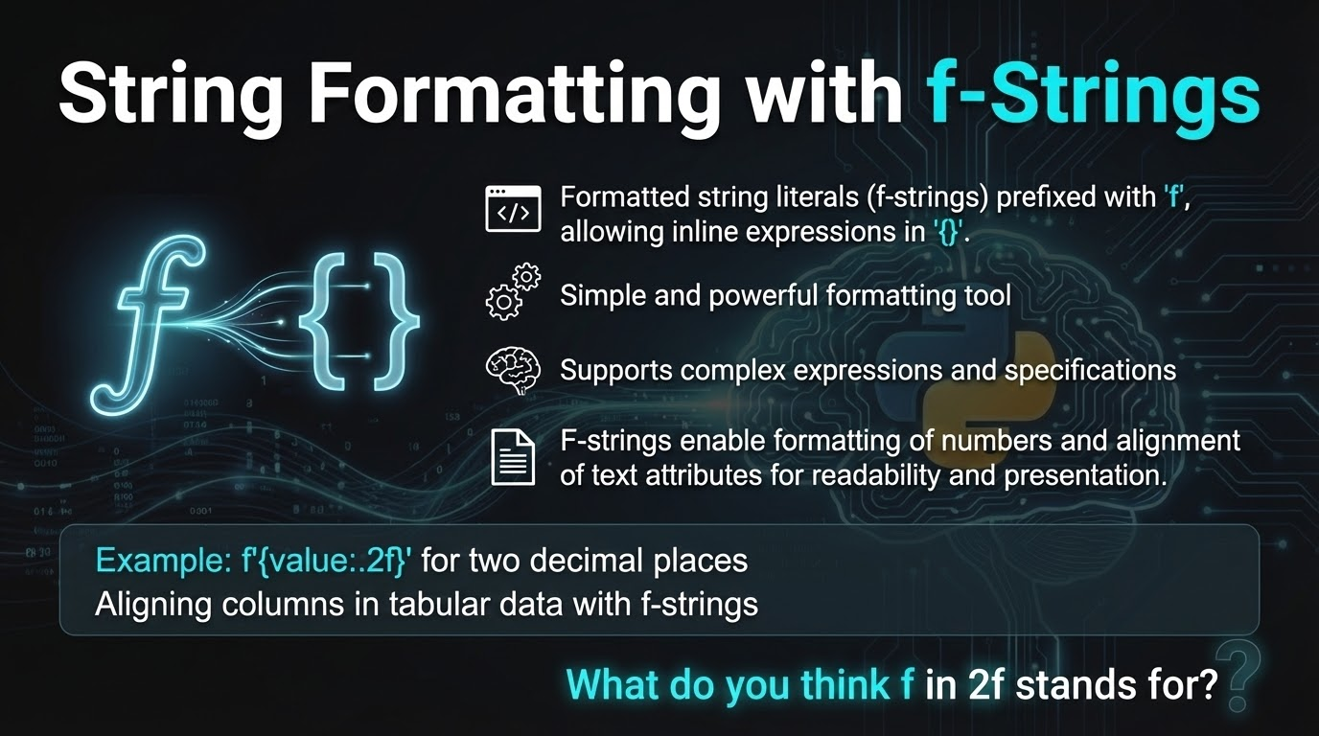
String Formatting with f-Strings
• Formatted string literals (f-strings) are prefixed with 'f', allowing inline expressions in '{}'.
◦ Simple and powerful formatting tool
◦ Supports complex expressions and specifications
• F-strings enable formatting of numbers and alignment of text attributes for readability and presentation.
◦ Example: f'{value:.2f}' for two decimal places
◦ Aligning columns in tabular data with f-strings
What do you think f in 2f stands for?

Slide 4
Code Example: Using f-Strings
value = 2.791514
print(f'approximate value = {value:.2f}') # approximate value = 2.79
car = {'tires':4, 'doors':2}
print(f'car = {car}') # car = {'tires': 4, 'doors': 2}
◦ Demonstrates f-string syntax in Python
◦ Flexible and concise for dynamic string creation
car is a Python Dictionary with 2 key:value pairs

Slide 5
Variables or expressions inside strings
name = "Alice"
age = 30
message = f"Hello, my name is {name} and I am {age} years old."
print(message)
Prefix f or F: The string literal is prefixed with f or F (e.g., f"..." or F"...").
Curly Braces {}: Variables or expressions are placed inside curly braces {} within the string. Python automatically evaluates these expressions and converts their results to strings, embedding them into the final string
Hello, my name is Alice and I am 30 years old.

Slide 6
Number Formatting (decimal places, thousands separator)
price = 19.99
total_cost = 19999.5678
formatted_price = f"The item costs ${price:.2f}"
formatted_total = f"Your total is ${total_cost:,.2f}"
print(formatted_price)
print(formatted_total)
:.2f: Formats a float to two decimal places.
:,.2f: Formats a float to two decimal places and adds a thousands separator.
The item costs $19.99
Your total is $19,999.57

Slide 7
Alignment and Padding
Use Gemini/Google Search to learn what alignment characters are in Python
item = "Laptop"
quantity = 2
padded_item = f"{item:<15} {quantity:>5d}"
print(padded_item)
:<15: Left-aligns the string within a field of 15 characters.
:>5d: Right-aligns the integer within a field of 5 characters.
Date and Time Formatting (using datetime module):
Laptop 2

Slide 8
Code Example: Print out tables with aligned columns
address_book = [{'name':'N.X.', 'addr':'15 Jones St', 'bonus': 70},
{'name':'J.P.', 'addr':'1005 5th St', 'bonus': 400},
{'name':'A.A.', 'addr':'200001 Bdwy', 'bonus': 5},]
for person in address_book:
print(f'{person["name"]:8} || {person["addr"]:20} || {person["bonus"]:>5}')
# N.X. || 15 Jones St || 70
# J.P. || 1005 5th St || 400
# A.A. || 200001 Bdwy || 5
Now center-align the name and address

Slide 9

Date and Time Formatting (using datetime module):
import datetime
now = datetime.datetime.now()
formatted_date = f"Today is {now:%A, %B %d, %Y}"
print(formatted_date)
%A: Full weekday name.
%B: Full month name.
%d: Day of the month as a zero-padded decimal number.
%Y: Year with century as a decimal number.
Today is Wednesday, November 19, 2025
These are predefined codes you can look up when needed

Slide 10
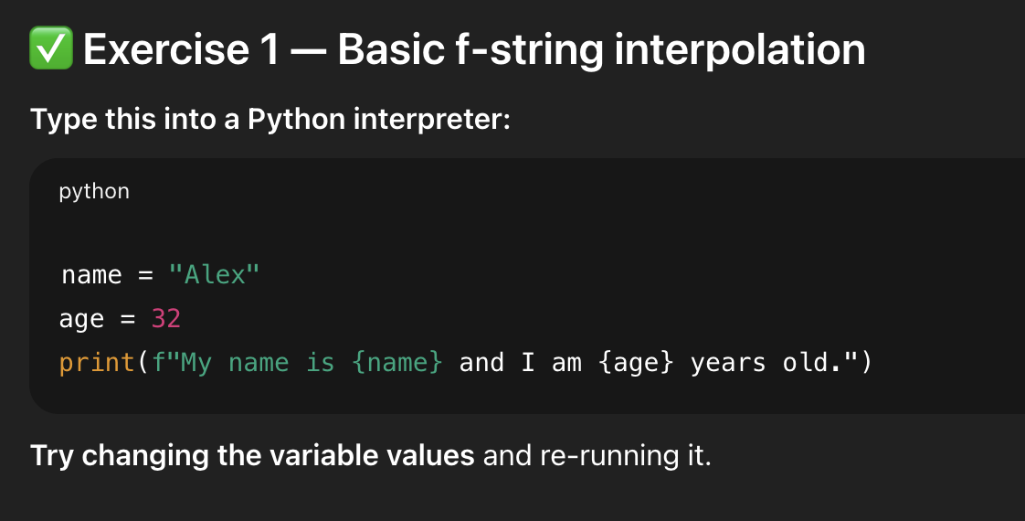
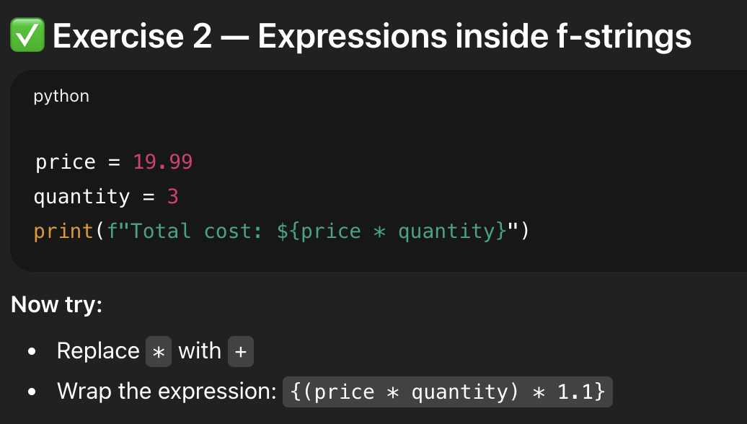
f-String Exercises 1 & 2

Slide 11
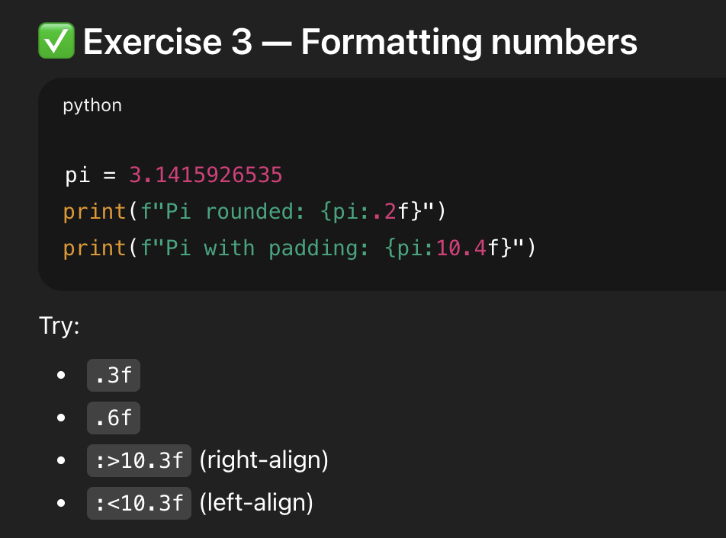
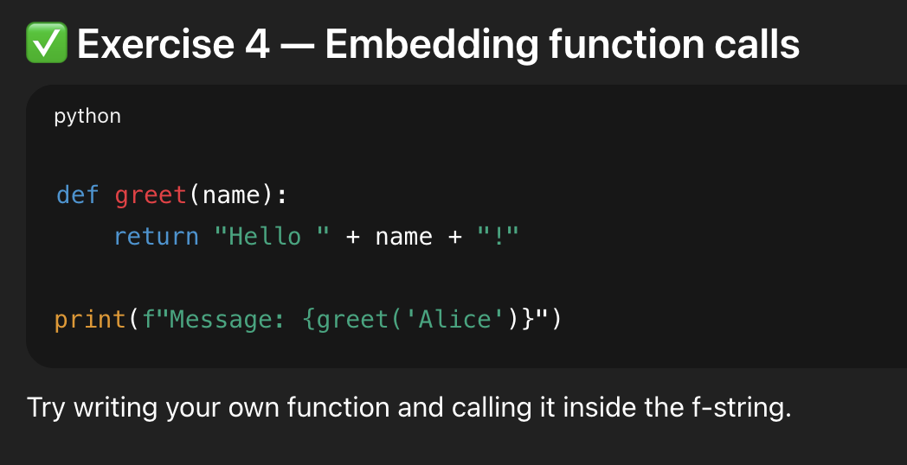
f-String Exercises 3 & 4

Slide 12
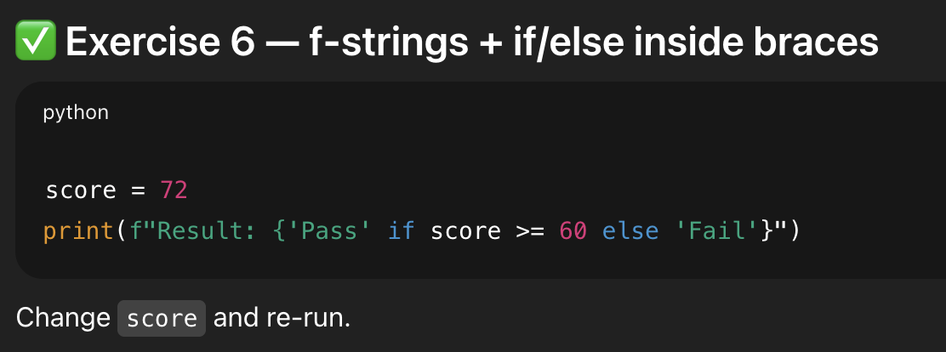
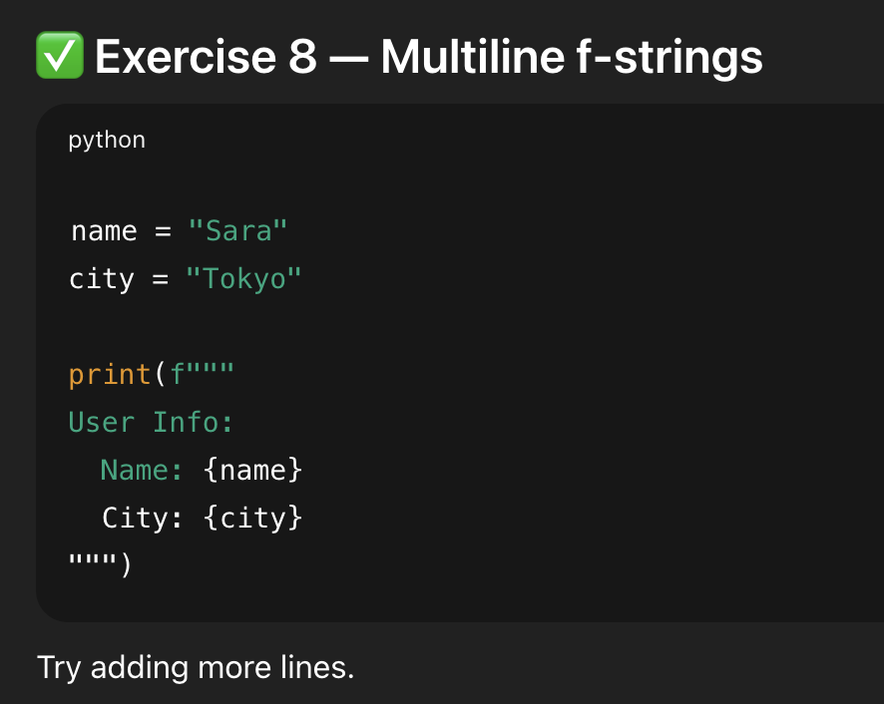
f-String Exercises 6 & 8

Slide 13
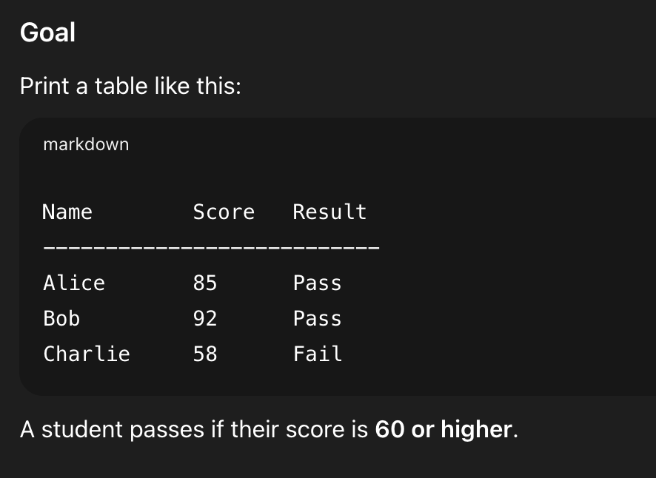
Quick Program Exercise
Starter Code:
# Step 1 — Create variables for each student
name1 = "Alice"
score1 = 85
name2 = "Bob"
score2 = 92
name3 = "Charlie”
score3 = 58
# Step 2 — Print the table header
print(f"{'Name':<10} {'Score':<6} {'Result':<6}")
print("-" * 28)
# Step 3 — Print each row using f-strings with an if/else expression
print( ___________________________________________ ) # Row 1
print( ___________________________________________ ) # Row 2
print( ___________________________________________ ) # Row 3

Slide 14
String %

Slide 15
String Formatting with % Operator
• Python supports a printf-style format with '%' operator, formatting strings similar to C-style syntax.
◦ Type specifiers include %d, %s, %f
◦ Multiple values provided in a tuple
# % operator

Slide 16
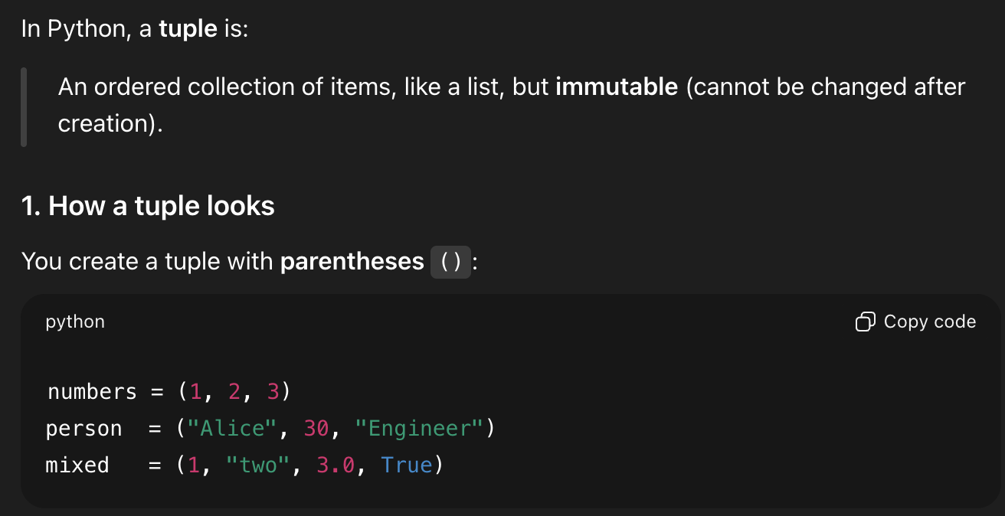
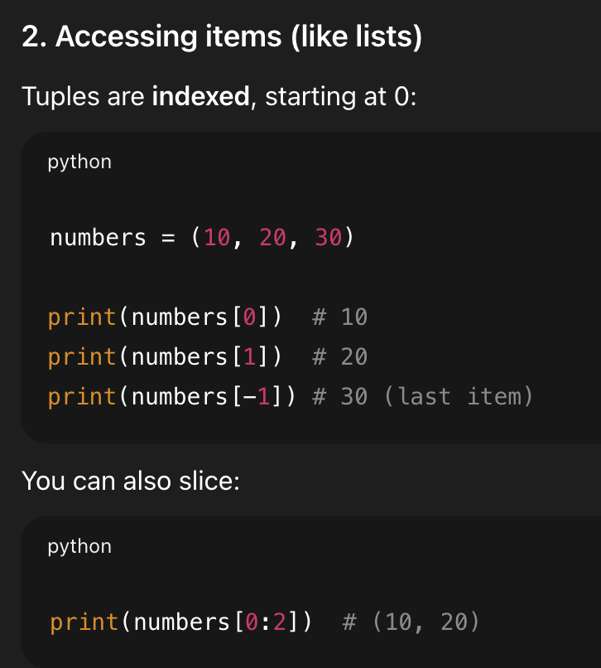
What is a tuple?

Slide 17
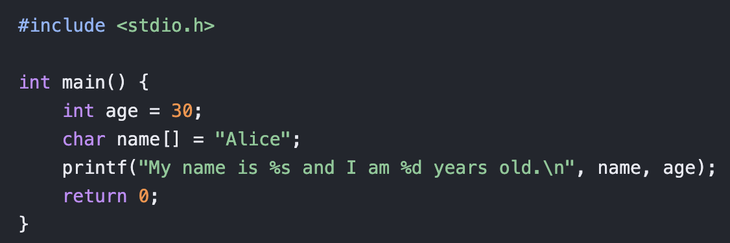
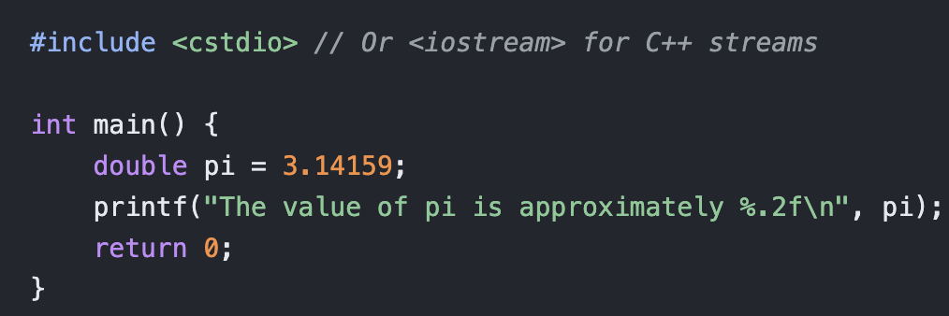
Code Examples in C and C++ programming languages
C:
C++:
What other differences can you see between this syntax and Python syntax?

Slide 18
Parentheses allow breaks across lines
# Add parentheses to make the long line work:
text = (
"%d little pigs come out, or I'll %s, and I'll %s, and I'll blow your %s down."
% (3, 'huff', 'puff', 'house'))
• Parentheses allow long format strings to break across lines for improved readability.
◦ Ensures clean, maintainable code
◦ Grouping helps avoid line length issues
Why do you need this in Python?

Slide 19
Automatic Concatenation of Strings across lines
# Split the line into chunks, which are concatenated automatically by Python
text = (
"%d little pigs come out, "
"or I'll %s, and I'll %s, "
"and I'll blow your %s down."
% (3, 'huff', 'puff', 'house'))
• Automatic concatenation of strings allows splitting long format strings into manageable parts
◦ Each segment is automatically combined
◦ Helps maintain clarity and structure

Slide 20
if Statements

Slide 21
Python if Statements
• Python uses colons and indentation instead of braces to define blocks of code for if/loops/functions.
◦ Indentation is mandatory (Improves code readability and structure)
◦ Boolean test does not need to be inside parentheses
◦ Falsy values: None, 0, empty string, empty list, empty dictionary
◦ Boolean type: True (converts to 1) and False (converts to 0)
◦ *elif* and *else* clauses (elif has a condition; else is optional)

Slide 22
Code Example: nested if statement with elif/else
Notice the indentation block structures
if time_hour >= 0 and time_hour <= 24:
print('Suggesting a drink option...')
if mood == 'sleepy' and time_hour < 10:
print('coffee')
elif mood == 'thirsty' or time_hour < 2:
print('lemonade')
else:
print('water')
What is printed if mood is “sleepy” and time_hour is 13?
What is printed if mood is “hungry” and time_hour is 1?
What is printed if mood is “happy” and time_hour is 11?

Slide 23
Comparison and Boolean Operators
• The if statement checks a condition that returns true or false, without requiring parentheses.
◦ Conditions determine the flow of logic
◦ Boolean operations guide decision-making
◦ For Boolean operators, use “and”, “or”, “not” → No C-style '&&', '||', or '!' operators
◦ Comparison operations can be used on strings: ==, !=, <, <=, >, >=
◦ Example: mood == 'sleepy' and time_hour < 10

Slide 24
Short Code can be on the Same Line (by preference)
if time_hour < 10:
print('coffee')
else: print('water')
Now write the code out on separate lines with proper indentation

Slide 25
Coding Exercises with Strings and If statements
Open up string2.py in Zed
As you’re still learning to code, try using pseudocode outline to organize your thoughts
.
Solve problem D. verbing => need to use slice to get last 3 letters s[-3:]
Solve problem E. not_bad => need to use find and replace
Solve problem F. front_back => need to use len(a)//2 and len(a)%2

Slide 26
F. front_back exercise in string2.py
len(a)//2 ## this gives you the integer number if you divide the first number by the second number. so 3//2 == 1 and 4//2 == 2.
len(a)%2 ## this is the modulus operator and gives you what’s left if you divide the first number by the second number. so 3%2 == 1 and 4%2 == 0
So if you want to determine if a string a is even or odd, len(a) % 2 == 0 means it’s even, else it’s odd

Slide 27
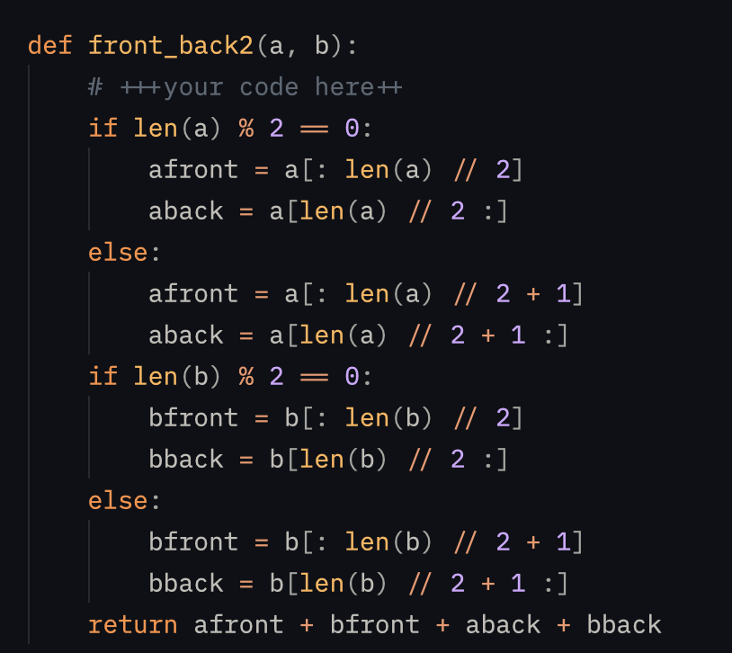
The Long Solution to front_back
Pseudocode:
If string a is even, split a into two even halves. Otherwise if it’s odd, give the extra char to the first half.
Repeat for string b.
Recombine the two strings.

Slide 28
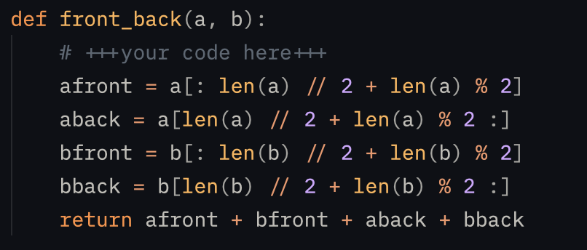
The Short Solution to front_back
Pseudocode:
Assign the front half of str a to half the length plus any remainders.
(Even length string will have no remainder, while odd length string will have remainder 1.)
Assign the back half of a to what’s left.
Repeat for str b.
Recombine the strings.

Slide 29
How to Test Multi-Lines of Python within Terminal
Interpreter
Press Enter in the interpreter after you type the first line
Ctrl-D to get out interpreter
Create a File
Touch newfile.py to create the file
Nano newfile.py (Nano is the file editor)
Ctrl-O to write/save file
Ctrl-X to exit file editor
Cat newfile.py to see its contents

Slide 30
Unicode and Bytes

Slide 31
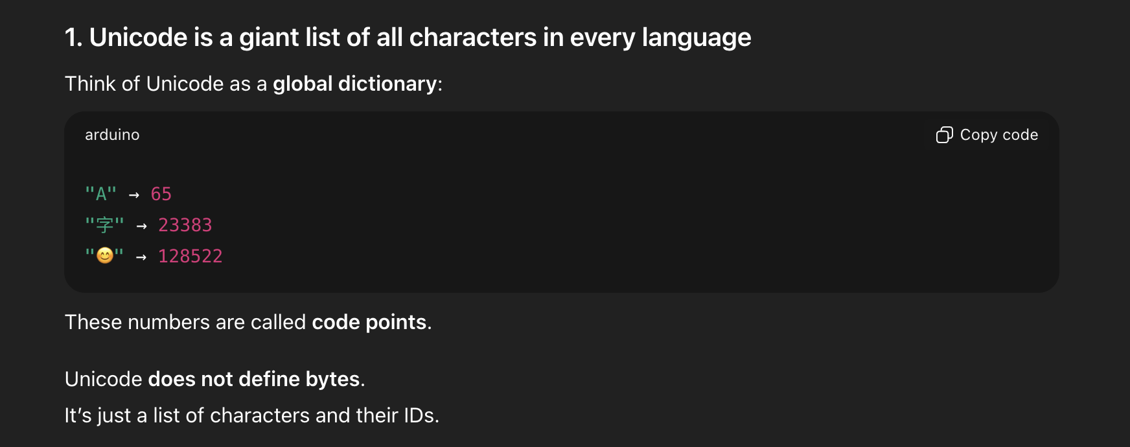
What is Unicode?

Slide 32
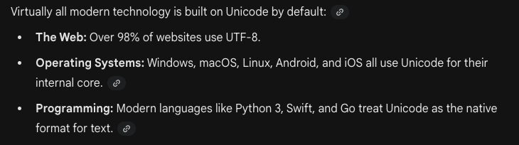
Unicode is the standard for handling languages

Slide 33
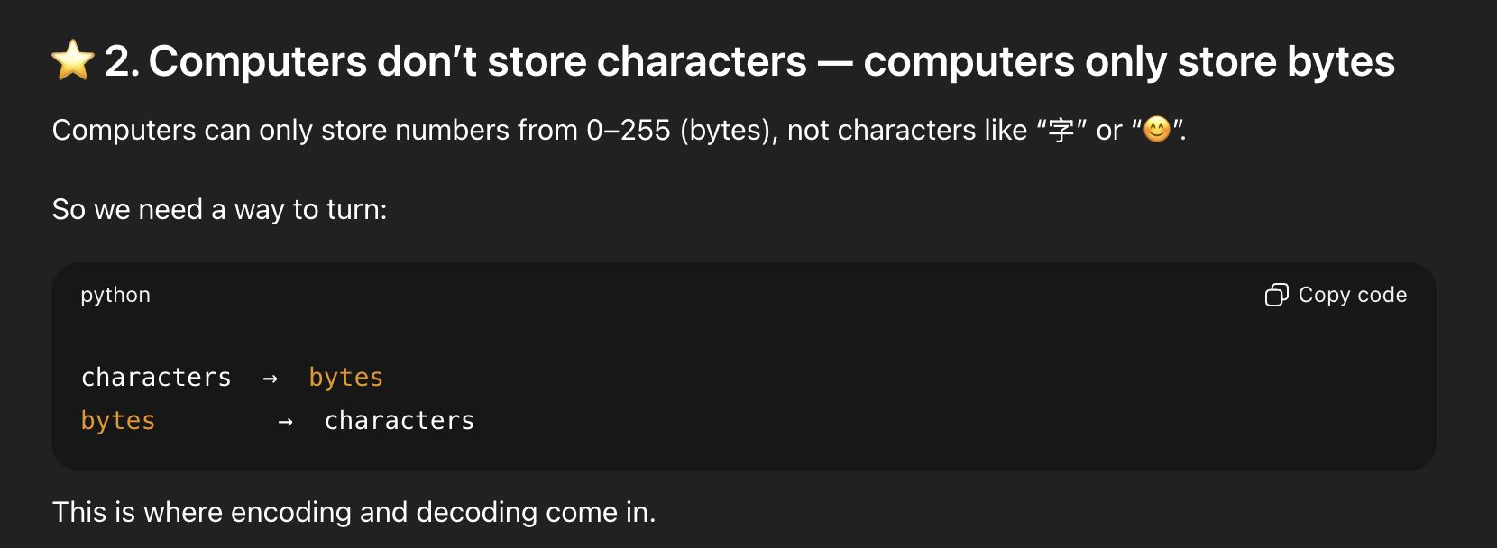
How to store characters on computers

Slide 34
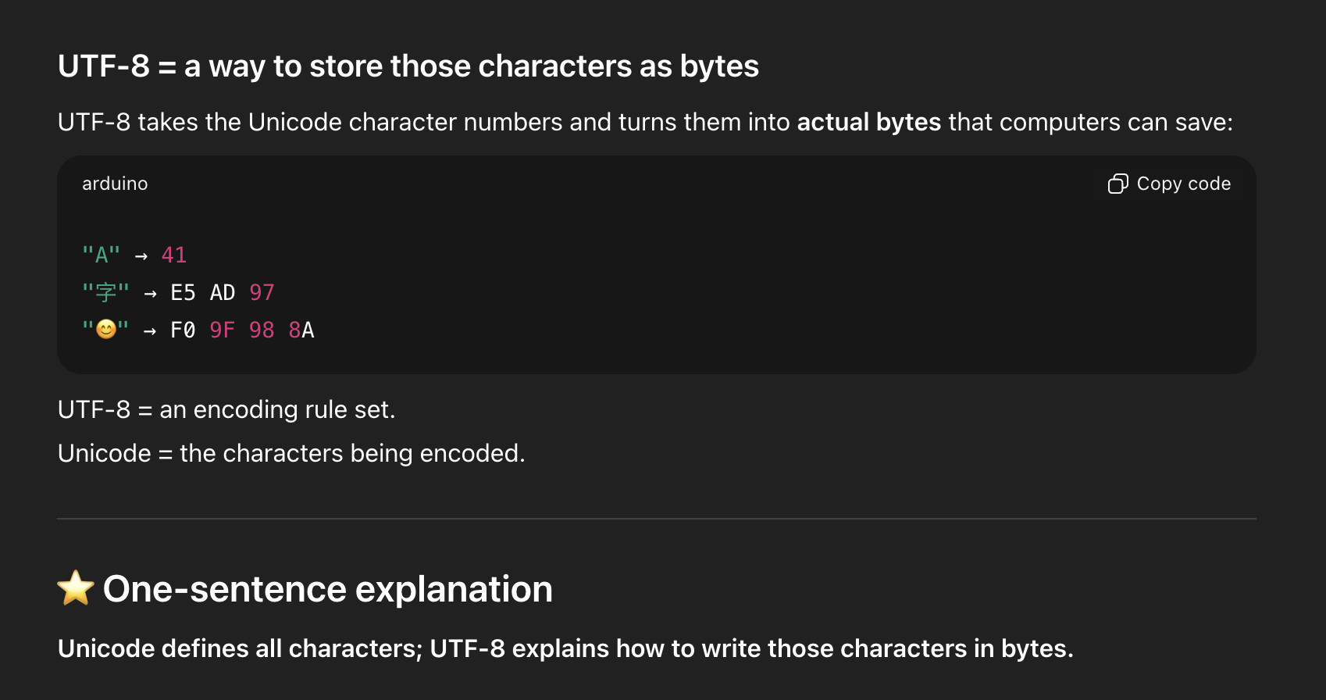
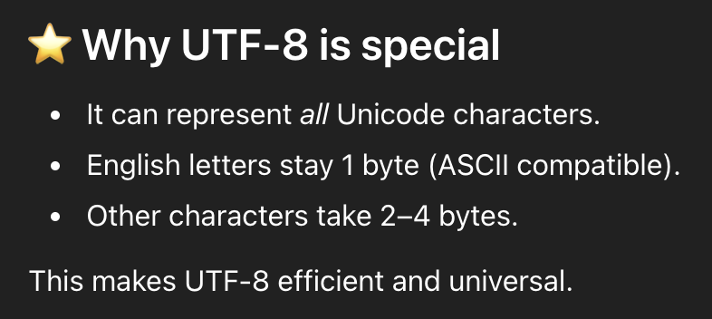
UTF-8 encodes characters to bytes

Slide 35
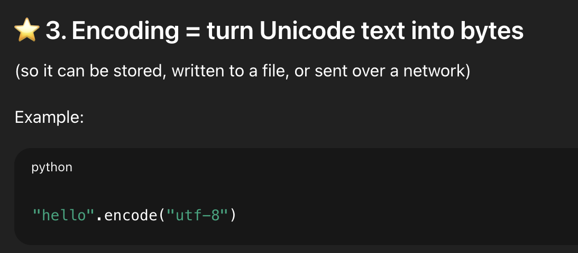
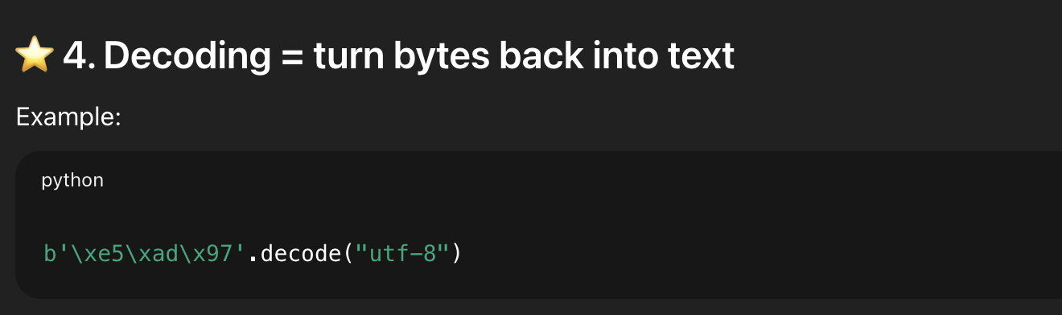
Encoding and Decoding in Python

Slide 36
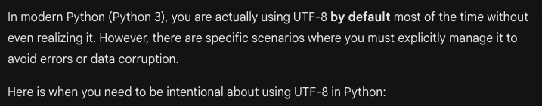
UTF-8 in Python
Opening and Saving Files
Working with Network Data (Web APIs)
Handling “UnicodeDecodeError”
Interfacing with Older Databases

Slide 37
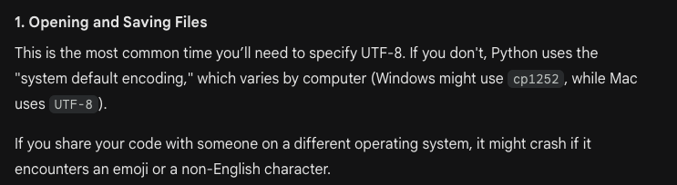

Opening and Saving Files
This code writes an emoji to a text file using utf-8 encoding.

Slide 38
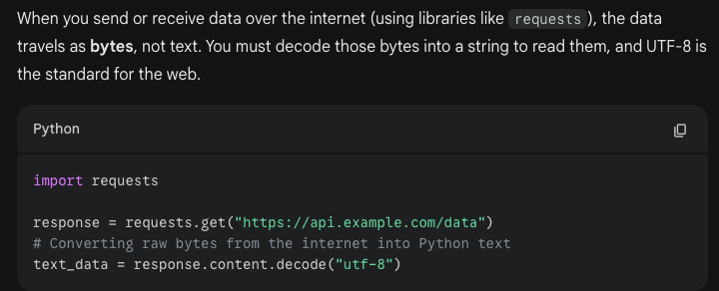
2. Working with Network Data (Web APIs)
n8n http request node decodes text data from api calls with utf-8

Slide 39
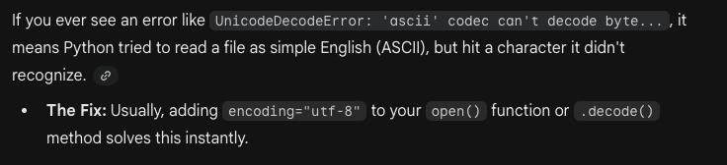
3. Handling “UnicodeDecodeError”

Slide 40
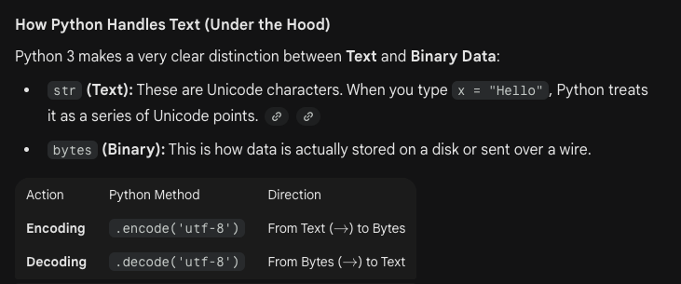
How Python handles Text

Slide 41
Python Strings: Unicode and Bytes
• Python strings are unicode by default; however, byte strings can be created with a 'b' prefix.
◦ Byte strings useful for binary data (e.g. network data, binary files)
◦ Preserve byte order across platforms
• Conversion methods like encode() and decode() work between unicode and byte strings seamlessly.
◦ Encoding uses formats like 'utf-8'
◦ Ensures consistent data representation

Slide 42
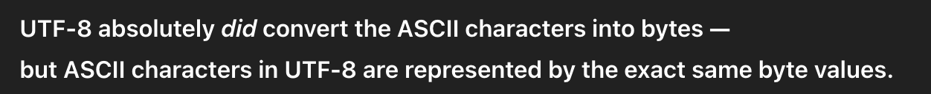
Code Example: Unicode and Bytes Strings
Non-ASCII Unicode characters
> ustring = 'A unicode \u018e string \xf1'
> b = ustring.encode('utf-8')
> b
b'A unicode \xc6\x8e string \xc3\xb1' ## bytes of utf-8 encoding. Note the b-prefix.
> t = b.decode('utf-8') ## Convert bytes back to a unicode string
> t == ustring ## It's the same as the original, yay!
True
◦ Conversion between unicode and bytes
◦ Important for handling binary data in Python
bytes

Slide 43
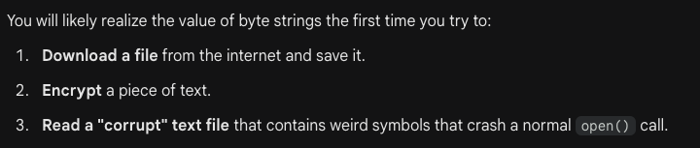
When you might encounter byte strings
(because encryption is performed on bytes)

Slide 44
End of Part Two

